Slide 1

Enhancing Dense Crowd counting CNN’s.
Rebecca Azoulay Christian Shakkour

Slide 2
Introduction
Demand for accurate crowd counting using CNN’s
Application of Computer Vision technology
Useful in many cases : event planning, safety and security, traffic, advertising
Good methods of crowd counting can also be extended to other domains, for instance, counting cells in biology
Many algorithms have been proposed for crowd counting in videos and images.

Slide 3
Existing solutions for videos
Method | Feedback
Detection-style framework | Occlusion among people in a clustered environment or in a very dense crowd significantly affects the performance of the detector
Cluster trajectories of tracked visual features | Do not work for estimating crowds from individual still images
Feature-based regression : segmenting the foreground extracting various features from the foreground, such as area of crowd mask utilizing a regression function to estimate the crowd count | Most extensively used method
Linear or piece-wise linear functions | Relatively simple models and yield decent performance
Ridge regression (RR), Gaussian process regression (GPR), and neural network (NN) | More advanced/effective methods

Slide 4
Existing solutions for still images
Multiple sources, namely, interest points (SIFT), Fourier analysis, wavelet decomposition, GLCM features, and low confidence head detections
Features extracted from a pre-trained CNN to train a support vector machine (SVM)
A CNN based method : use of a similar training based on the perspective and density map. Problem : perspective maps not readily available in many applications.

Slide 5

Problem
Lack of precision
Perspective maps not readily available in many applications.

Slide 6
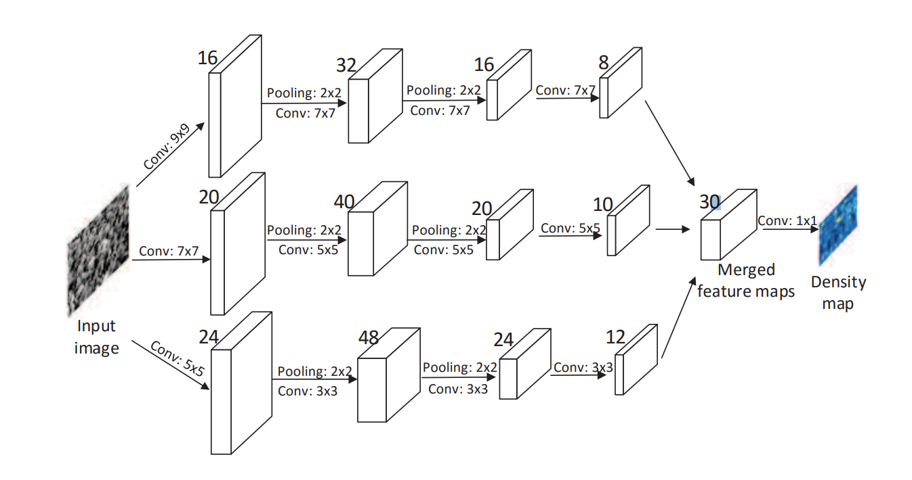
Our solution
Extend a multi-column deep neural networks for image classification by adding another column.
In the original model, an arbitrary number of columns can be trained on inputs preprocessed in different ways.
Current CNN’s Network

Slide 7
Results

Slide 8
Conclusion
Conclusion
Future work

